Slide 1
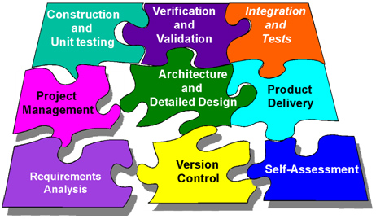
The Nature and Role of Professional Societies and Software Engineering Standards
By Group 6

Slide 2
Contents
Software Engineering Nature
Software Engineering Roles
Software Engineering Standards
What are standards
How are standards developed?
How long are standards active?
Who uses standards?
How are standards named?
Groups Dynamics and Psychology
Communication Skills
References

Slide 3
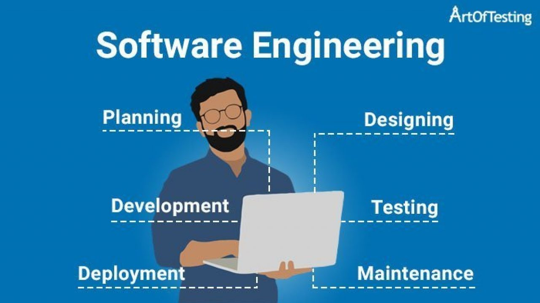
Software Engineering Nature
Software engineering is a science that deals with the design, implementation, and maintenance of complex computer programs.
It is the process of application of technological knowledge in order to design, implement, and document a given software.

Slide 4
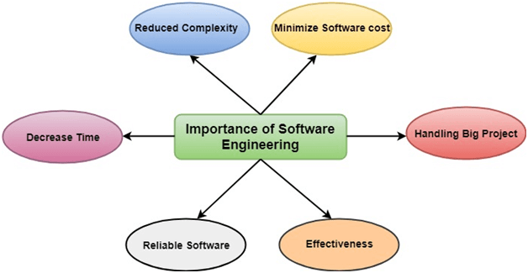
Software Engineering Nature (Cont’d…)
The major 6 qualities of a Software:
Functionality
Reliability
Usability
Efficiency
Maintainability
Portability

Slide 5
Software Engineering Roles
Software engineering has a wide scope with different roles based on its complexity level.
Accordingly some types of roles of software engineering are listed and discussed below.
Front end engineer: are software engineers who specialize in user interface (at which human users interact with a computer, application or website).
Back end engineer: are the once who deal with the internal logic and performance of application

Slide 6
Software Engineering Roles (Cont’d…)
Full end engineer: are the individuals who can handle job of both front and back end engineers.
Software engineer in test: is a software engineer who is responsible for writing software to validate the quality of the application.
DevOps engineer: is an engineer who introduces processes, tools, and methodologies to balance needs throughout software development life cycle.
Security engineer: is an engineer who specialize in creating methods to check the security of software’s by exploiting and fixing the flaws in it. They are what we call a white hat hackers (ethical hackers) who try to penetrate the system to discover its vulnerabilities.

Slide 7
Software Engineering Standards
Main topic

Slide 8
Software Engineering Standards
Governments, industry, and user organizations have long realized that it is not sufficient to rely simply on the intelligence, cleverness, and integrity of individuals or organizations to produce worthwhile software.
Many sets of standards have been written to better control the process of software development.

Slide 9
What are Standards?
Standards are published documents created to ensure the reliability of the materials, products, methods, and/or services, by establishing requirements, specifications, guidelines, characteristics, and/or procedures.
Defines the software engineering process, activity, and tasks that are associated with a software life cycle process from conception through retirement.

Slide 10
What are Standards? (Cont’d…)
The standard has the main objective of supplying a common structure so that the buyers, suppliers, developers, maintainers, operators, managers and technicians involved with the software development use a common language.
It aims to be 'the' standard that defines all the tasks required for developing and maintaining software and the process of software development.

Slide 11
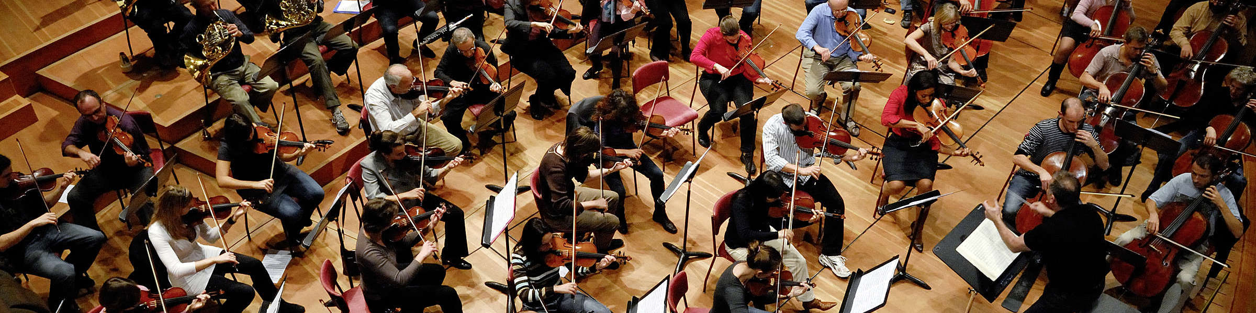
How are Standards Developed?
Typically, they are developed through a consensus process and approved by various national and international agencies, professional societies, or industry organizations.
It takes a lot of people working together to develop a standard.
The following are a few examples of how standards organizations develop their standards:

Slide 12

ISO(International Standardization Organization)
Nominated experts form a technical committee that is responsible for a specific subject area begin the process with the development of a draft that meets a specific market need.
The voting process is the key to consensus. If that’s achieved then the draft is on its way to becoming an ISO standard.
If agreement isn’t reached then the draft will be modified further, and voted on again.
From first proposal to final publication, developing a standard usually takes about 3 years.

Slide 13

ASTM(American Society for Testing and Materials)
A full consensus standard is developed by a cross-section of stakeholders with an interest in its use.
When there is a need for new standards, requests can come from trade associations, government agencies, and professional societies that do not create their own standards; or manufacturers, consumer groups, and even individuals. The request is presented to an ASTM technical committee and the process of standards development begins.

Slide 14
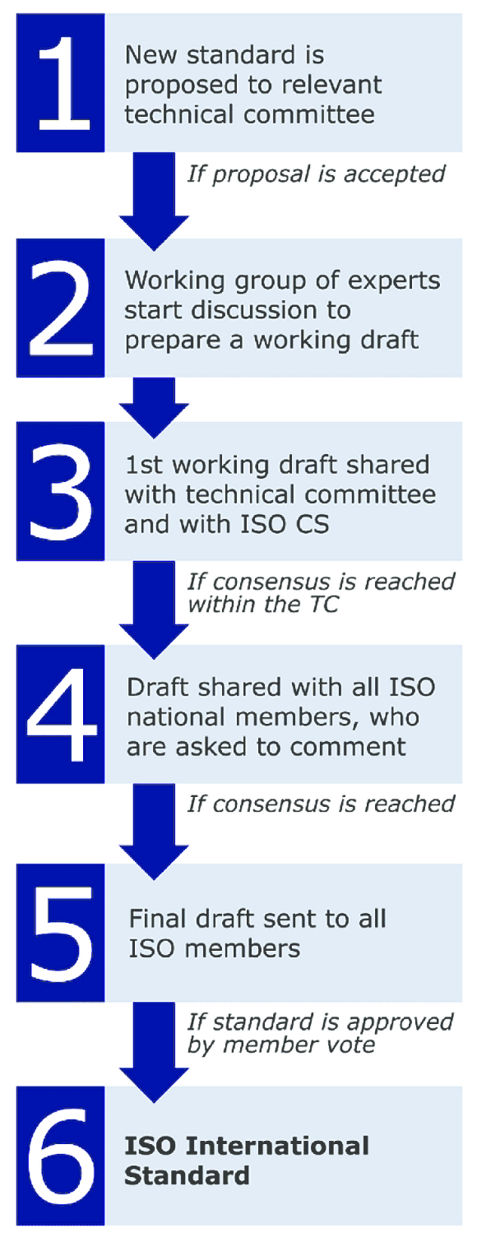
Key principles in Standard Development
Respond to a Need in the Market
Based on Global Expert Opinion
Developed Through a Multi-Stakeholder Process
Based on Consensus

Slide 15
How Long are Standards Active?
The time frame in which a standard remains active varies based on the standards organization's review and revision processes.

Slide 16
Who uses Standards?
Small businesses
National and International businesses
Governments
Engineers
Scientists
Architects
Designers, Students, etc.

Slide 17
Why are Standards Important?
Enhance health, safety and quality of life
Improve performance
Reduce risk
Become more sustainable
Facilitate global trade and market access
Help produce efficient and effective products
Reduce costs, improve supplier relations
Guide business communications and marketing
Advance innovation and new technologies
Support regulatory goals and compliance
Transfer technology to the marketplace
Make modern conveniences possible

Slide 18
What are some of the risks of not identifying and not complying with relevant current standards?
Inability to sell completed product
Damage relationship with suppliers
Interoperability issues
Product not approved by regulators
Possible governmental sanctions, fine, and/or reprimands
Possible civil lawsuits
Possible criminal lawsuits
Loss of revenue
Accidents
Illness
Property damage
Loss of professional license
Loss of or inability to obtain insurance

Slide 19
What types of standards exist?
The following are a few examples of how different standards granting organizations publish different types of standards.
ANSI: basic, design, management systems, process, product, test methods, and others
ASTM: specification, test method, terminology, practice, guide
ISO: product, test methods, codes of practice, guideline, management systems

Slide 20
How are standards named?
Standards are named using the acronym of the standard granting organization, the number of the standard, and the year the standard was issued.
ASCE/SEI 7-16
ASTM F963-17
ISO 13485:2016

Slide 21
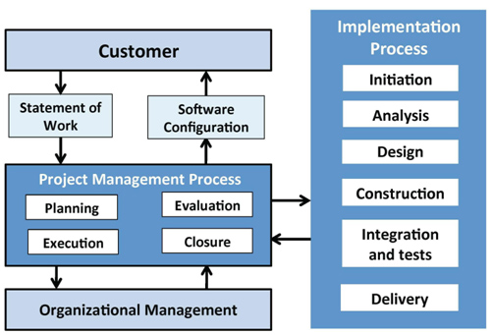
Software Engineering Standards (cont’d…)
Over 230 active, draft and archived standards are published and are used throughout the industry today

Slide 22

Group Dynamics and Psychology
Group dynamics psychology is the understanding of patterns, roles, behaviors, structure, and communication within groups.

Slide 23
Group Dynamics and Psychology (Cont’d..)
A software engineer must be able to interact cooperatively and constructively with others to first determine and then meet both needs and expectations.
Knowledge of group dynamics and psychology is an asset when interacting with customers, coworkers, suppliers, and subordinates to solve software engineering problems.

Slide 24
Group Dynamics and Psychology (Cont’d..)
These assets can have a say in:
Dynamics of Working in Teams/Group:
Making use of group thinking, admitting ignorance, and acknowledging mistakes. Sharing responsibility, rewards, and workload fairly, taking care to communicate clearly, directly to each other and in documents, as well as in source code.
In general, members of cohesive teams demonstrate respect for each other and their leader.
Individual Cognition
The ability to solve problems effectively and efficiently is what every engineer strives for.
However, there are limits in individual cognition affect problem solving that require group work.

Slide 25
Group Dynamics and Psychology (Cont’d..)
Dealing with problem complexity
Many software engineering problems are too complex and difficult to address as a whole or to be tackled by individual software engineers.
When such circumstances arise, the usual means to adopt is teamwork and problem decomposition.
Interacting with stakeholders
Success of a software engineering endeavor depends upon positive interactions with stakeholders.
They should provide support, information, and feedback at all stages of the software life cycle process.

Slide 26

Group Dynamics and Psychology (Cont’d..)
Dealing with uncertainty and ambiguity
In this case, investigation through recourse to formal sources such as textbooks and professional journals, interviews with stakeholders, or consultation with teammates and peers can overcome it.
Dealing with Multicultural environments
For a software project to be a success, team members must achieve a level of tolerance and acknowledgment.

Slide 27

Communication Skills
It is vital that a software engineer communicate well, both orally and in reading and writing.
Successful attainment of software requirements and deadlines depends on developing clear understanding between the software engineer and customers, supervisors, coworkers, and suppliers.
It follows that the software engineer’s own career success is affected by the ability to consistently provide oral and written communication effectively and on time.

Slide 28

Communication Skills (Cont’d…)
It includes:
Reading, Understanding, and Summarizing
Technical materials, gathered information, source code
Writing
Source code, software project plans, software requirement documents, diagrams and charts, software design documents and so forth
Team and Group Communication
Presentation Skills
During and after software design, software construction, and software maintenance
Influencing product acceptance, management, customer support and the ability of stakeholders to assist in the product effort.

Slide 29



Reference Materials
mks075, "software engineering | software characteristics," 18 August 2021. [Online]. Available: https://www.geeksforgeeks.org/software-engineering-software-characteristics/. [Accessed 7 April 2022].

